Slide 1


Comparative Analysis of Proteins in the Mouse Brain: Building a database
Introduction to Biotechnology
Defteraiou Maria
Konstantinidis Konstantinos
Mertzani Styliani
Voulgari Despoina
February 2025

Slide 2
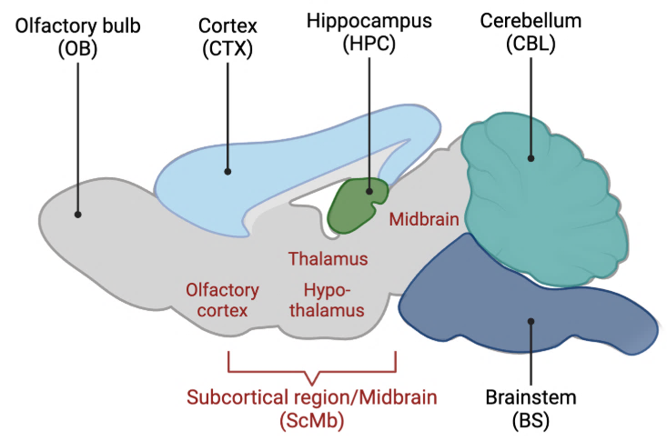
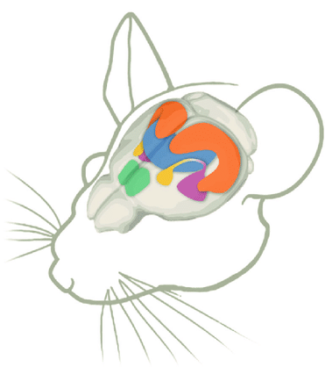
Mouse Brain Regions
Medulla
(MD)

Slide 3

Data Preprocessing
Challenges:
Column names differed → needed standardization
Different formats → needed conversion
Loaded datasets
(excel files → pandas df
Checked for missing values
01
02
03
04
Renamed columns
(Standarized to “Uniprot_ID” for easy processing
Stored datasets in dictionaries for easy access

Slide 4

Extracting Unique & Common Proteins
2795
Goal: Find proteins present in both datasets vs. unique to each
2391
2311
2334
2247
2246
2250
Convert list of protein IDs to sets
05
06
Used set operation to find common and unique proteins
New Data
10
Old Data
MD
OB
HT
CB
CC
HC
MB

Slide 5
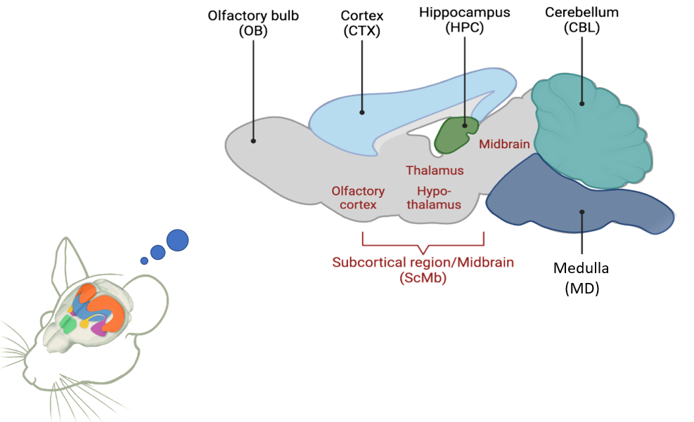
Unique Proteins
Unique Proteins per Brain Region
The identification of the unique proteins in each brain regions allows to better understanding brain functions and regional specialization
Unique
Total
Brain Regions
Observations
Some regions have more new unique proteins → possibly due to better data quality
Cortex and hippocampus had the most shared proteins

Slide 6
Biological Interpretation
What do the protein differences mean?
Some proteins may have been missing in older datasets due to lower sensitivity
New dataset includes novel proteins that could be functionally relevant
Could indicate region-specific changes in brain function

Slide 7
Introduction to Gene Ontology (GO) Analysis
What is Gene Ontology?
Gene Ontology (GO) is a framework for the functional annotation of genes and proteins. It provides a standardized vocabulary to describe gene products in terms of their:
Biological Process (BP): What broader biological processes the gene/protein is involved in (e.g., cell division, signal transduction).
Molecular Function (MF): The specific molecular activities of the gene/protein (e.g., kinase activity, DNA binding).
Cellular Component (CC): Where the gene/protein is located in the cell (e.g., nucleus, cytoplasm, membrane).

Slide 8
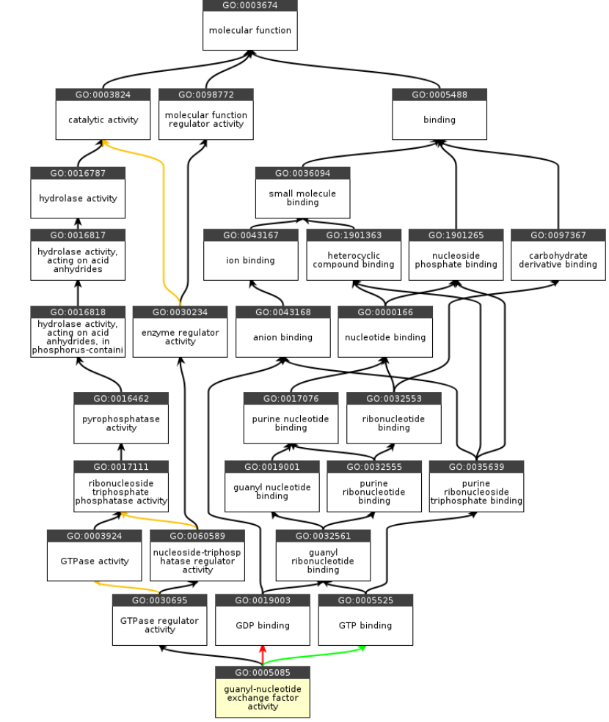
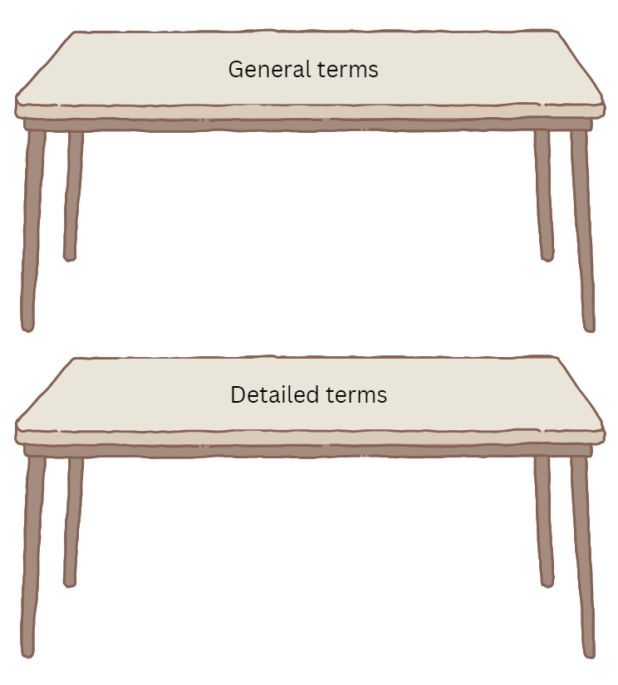
Parent GO
Child GO term 1st Level
Decision
Quick GO API
Traceback
Process
Final Tables
Decision
Decision
Uniprot API
Child GO term as seen in Uniprot
Finish

Slide 9
Old Dataset

Slide 10
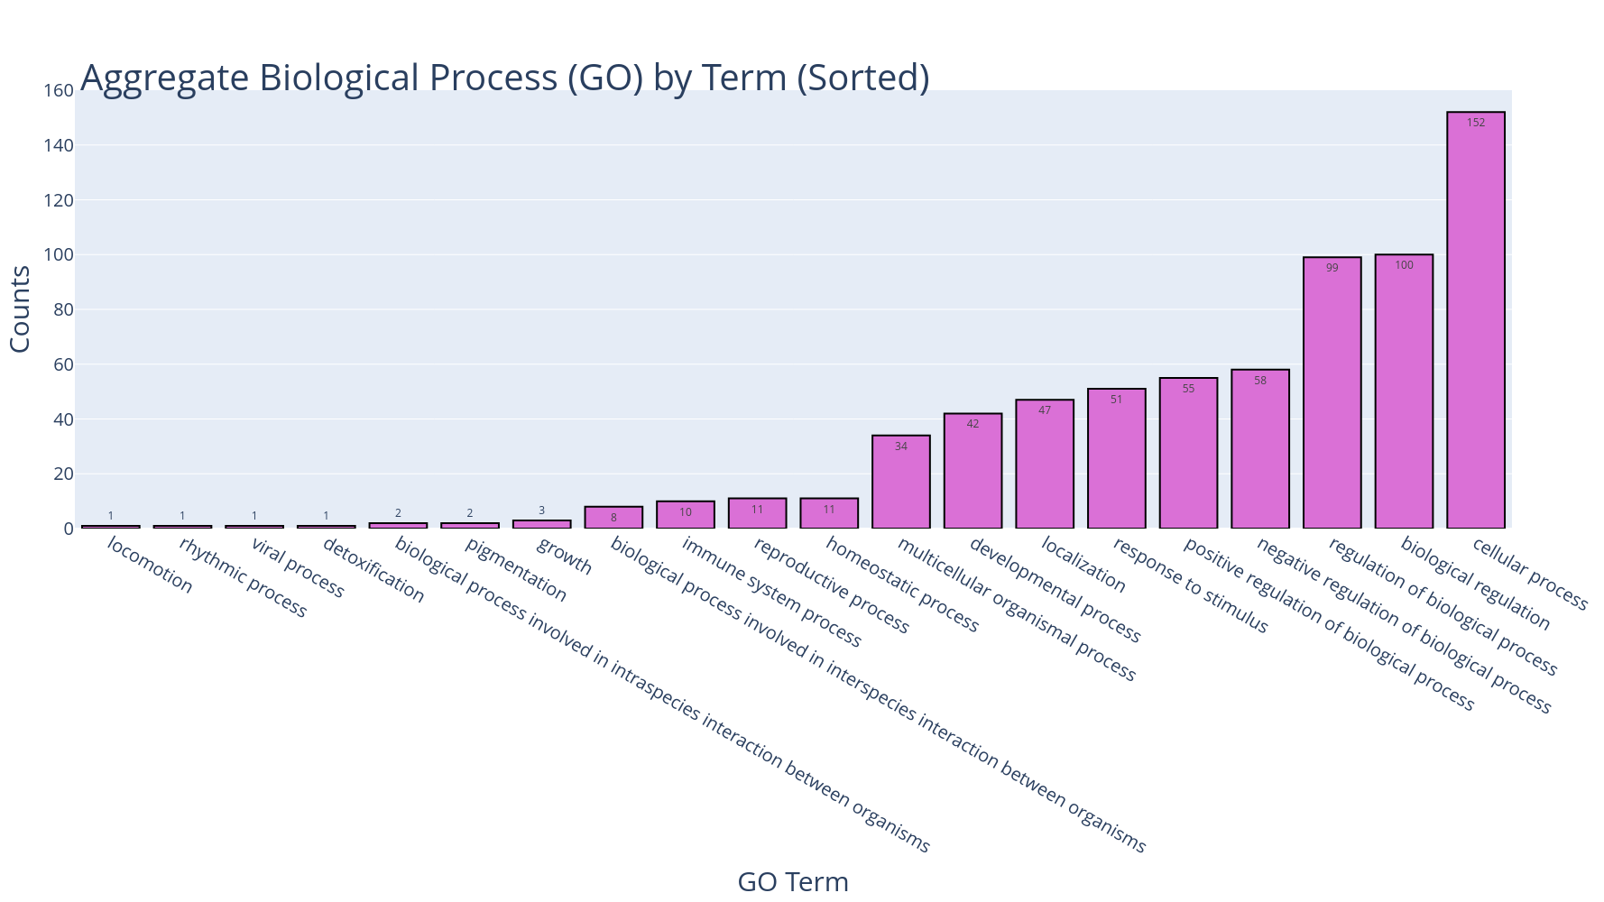

Slide 11
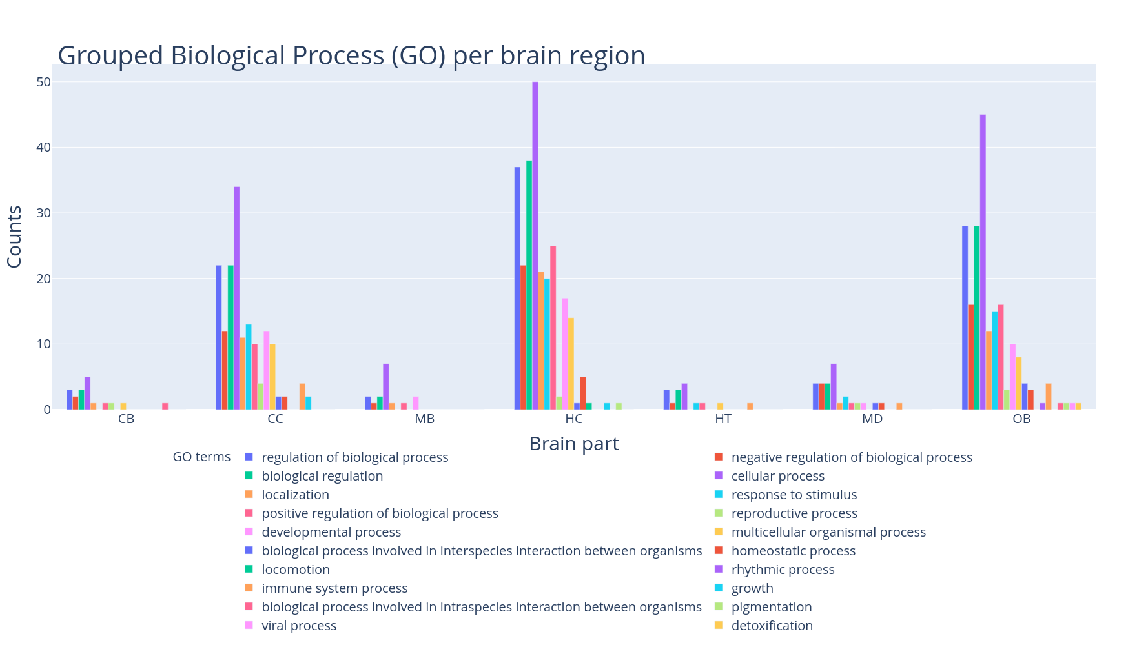

Slide 12
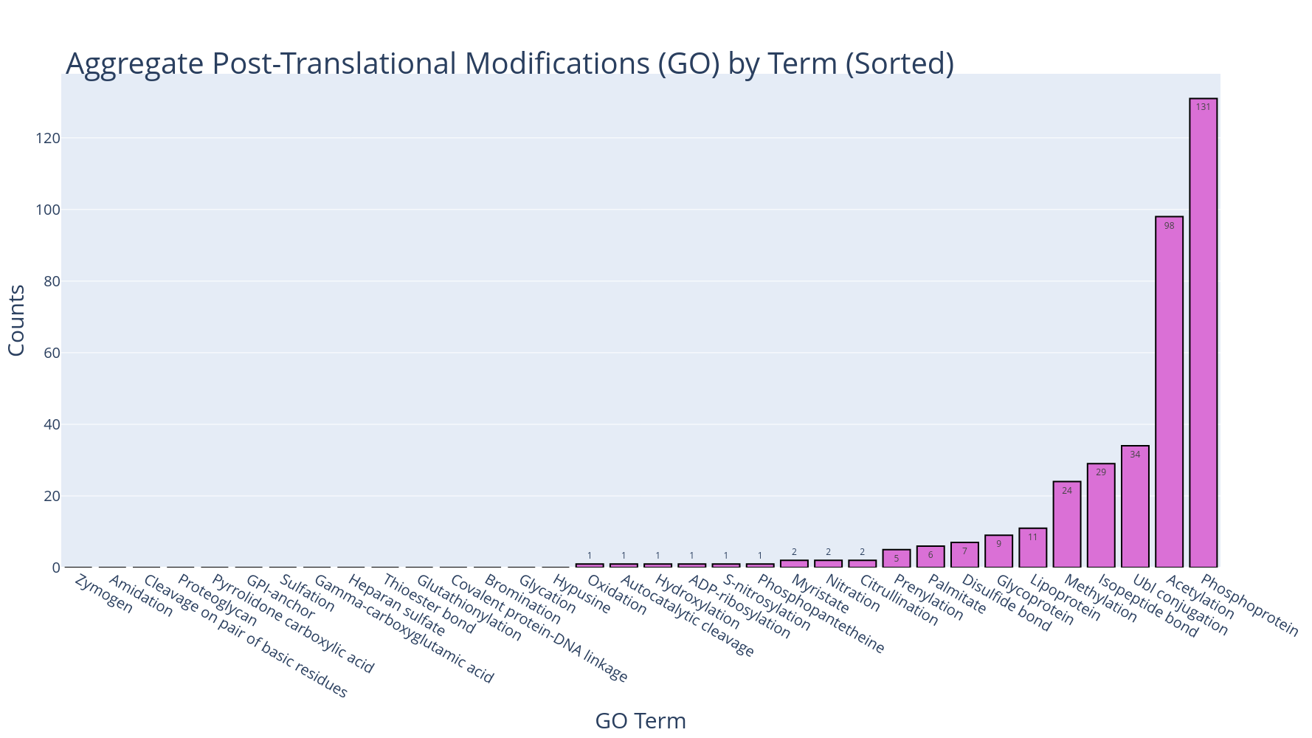

Slide 13
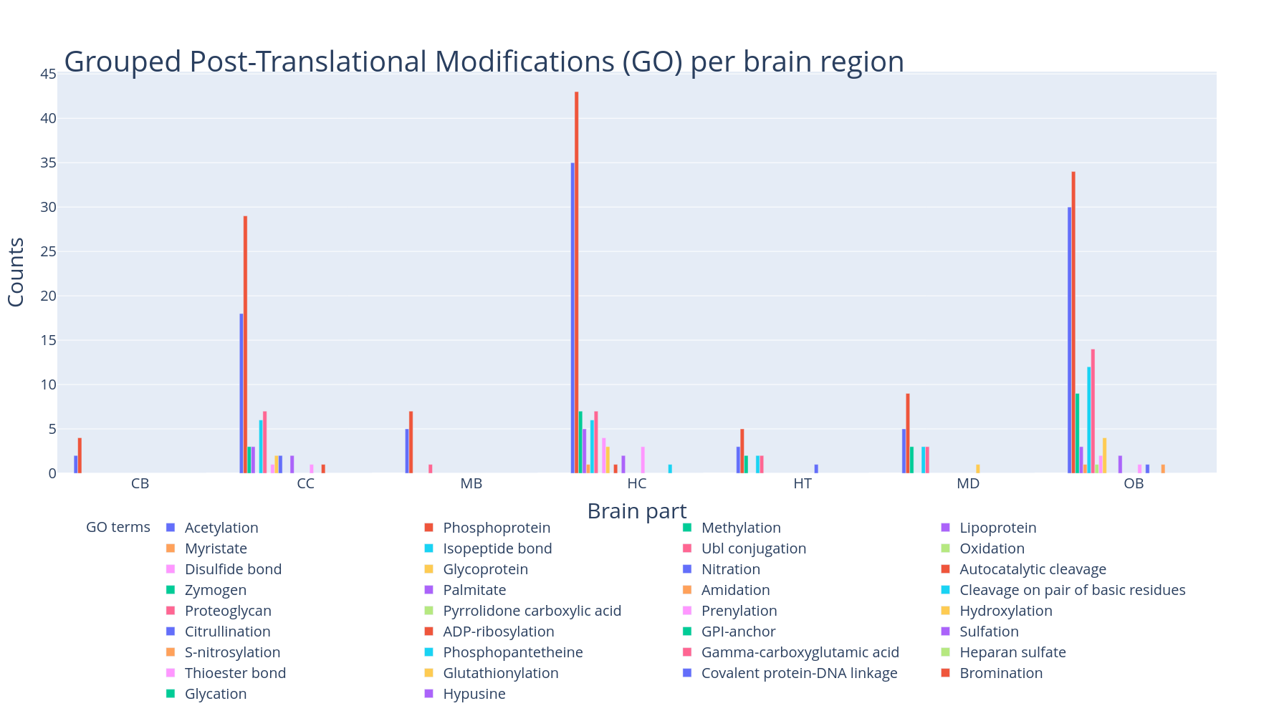

Slide 14
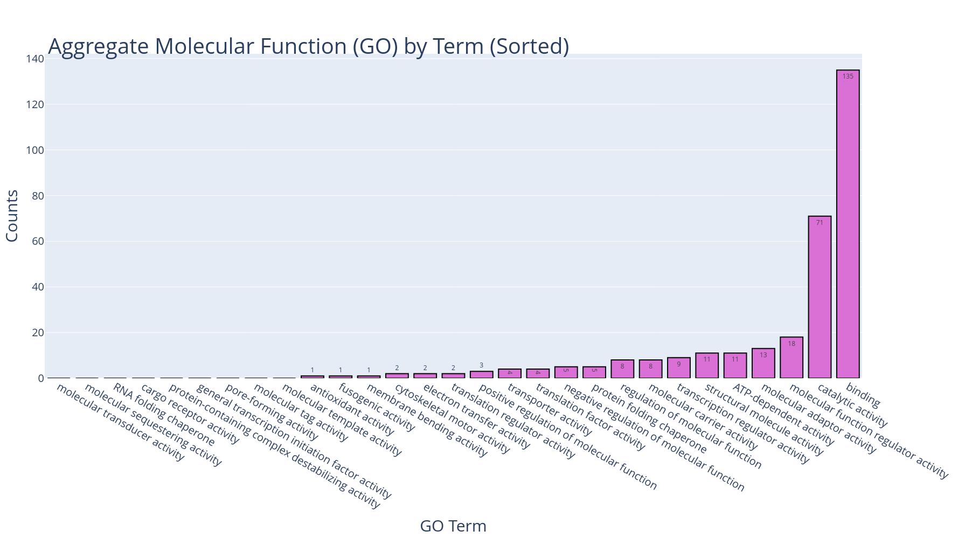

Slide 15
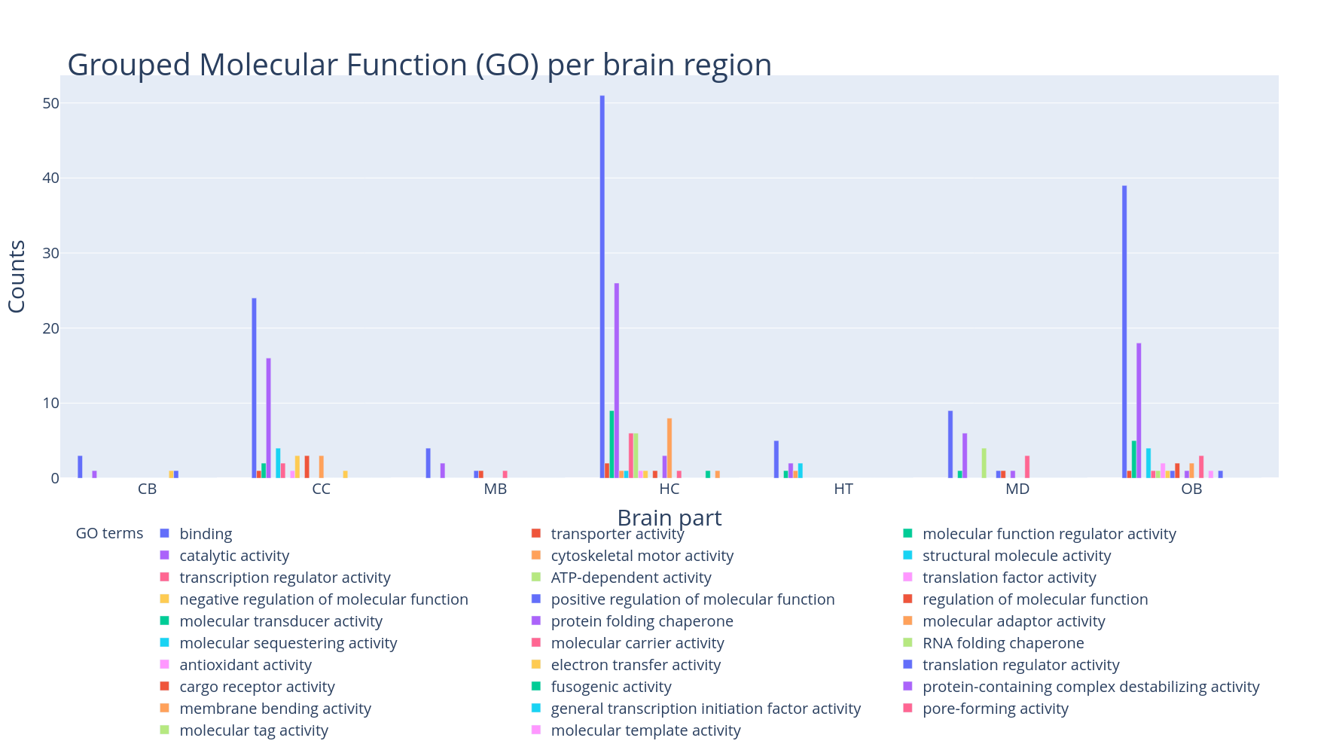

Slide 16
New Dataset

Slide 17
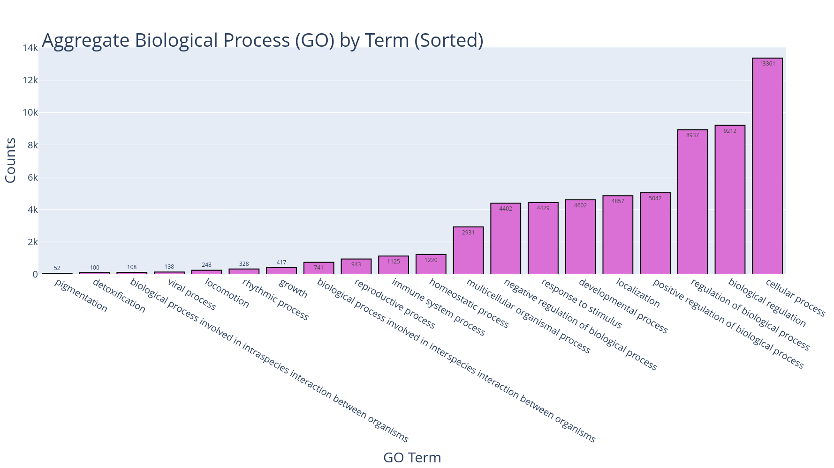

Slide 18
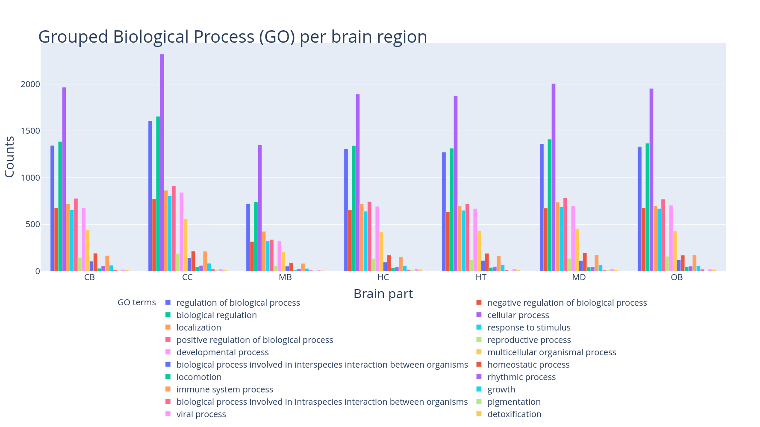

Slide 19
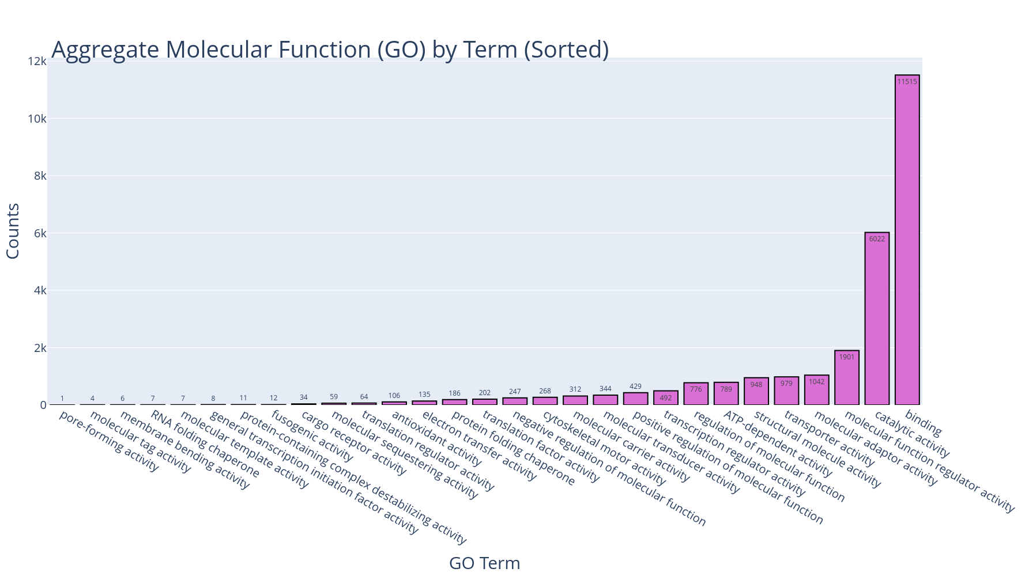

Slide 20
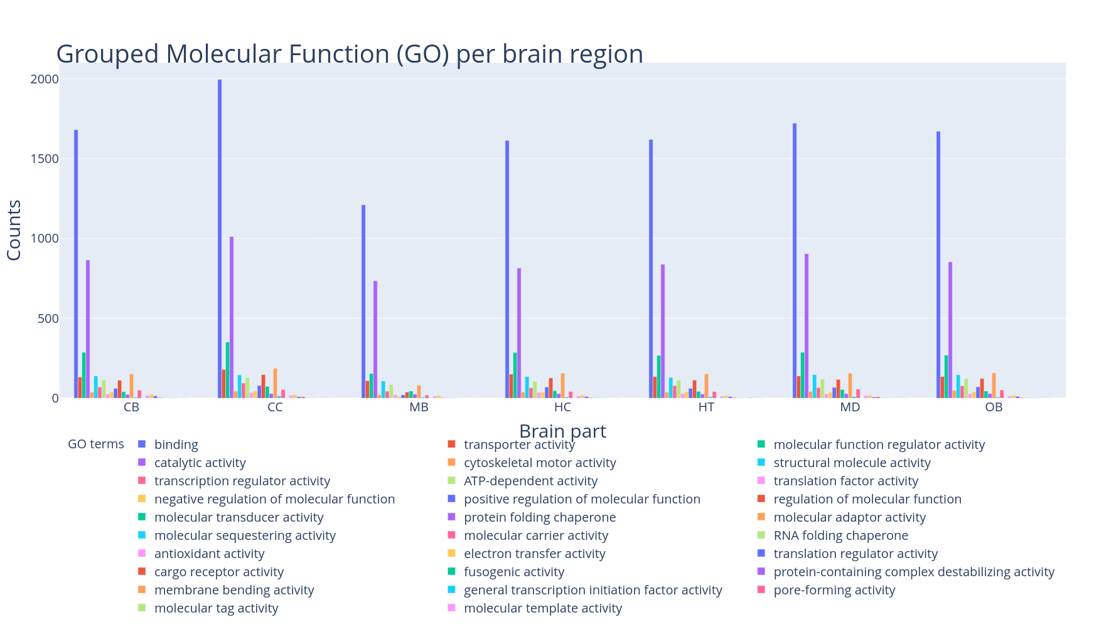

Slide 22
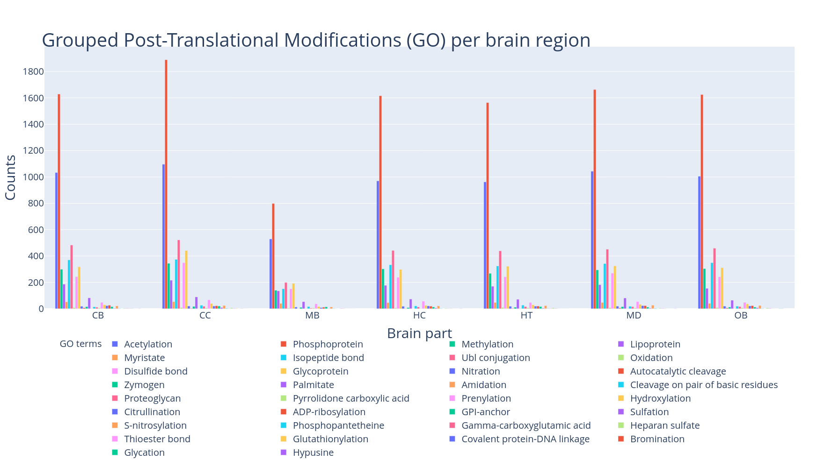

Slide 23
Database Design

Slide 24

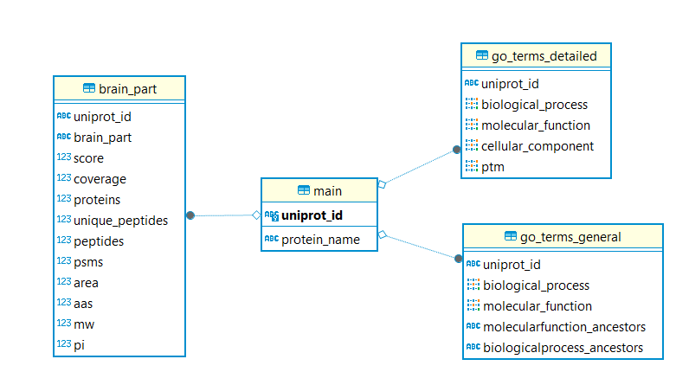

Database Architecture
Primary Key : Uniprot ID
Tables
Main
All proteins with unique Uniprot IDs
Brain part
Six different brain parts with key metrics connected to each protein
GO terms general
GO terms divided to general Biological processes and Molecular functions
GO terms detailed
GO terms divided to further detailed ontologies

Slide 25
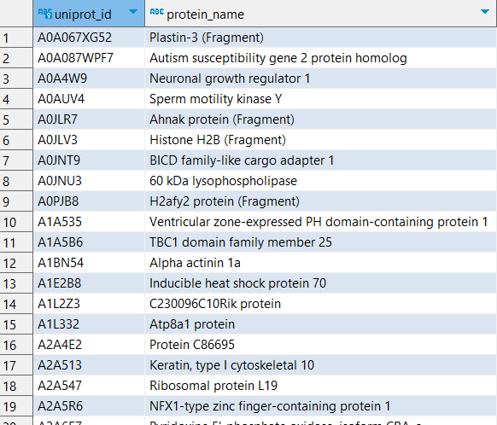
Insightful Queries
Unique proteins in brain regions
SELECT m.uniprot_id, m.protein_name
FROM public.main m
JOIN public.brain_part bp ON m.uniprot_id = bp.uniprot_id
GROUP BY m.uniprot_id, m.protein_name
HAVING COUNT(DISTINCT bp.brain_part) = 1;
Other insightful queries
Most Abundant Proteins in Each Brain Region
Most Common Biological Processes in Each Brain Region
Proteins Involved in Multiple Brain Regions
Highly Connected Proteins (Potential Hubs)
Total Proteins: 6.336
Brain regions: 6

Slide 26
Sample Queries
Most Abundant Proteins in Each Brain Region
Proteins Involved in Multiple Brain Regions
SELECT bp.brain_part, m.uniprot_id, m.protein_name, bp.area
FROM public.brain_part bp
JOIN public.main m ON bp.uniprot_id = m.uniprot_id
ORDER BY bp.brain_part, bp.area DESC
LIMIT 5;
SELECT m.uniprot_id, m.protein_name, COUNT(DISTINCT bp.brain_part) AS brain_part_count
FROM public.brain_part bp
JOIN public.main m ON bp.uniprot_id = m.uniprot_id
GROUP BY m.uniprot_id, m.protein_name
HAVING COUNT(DISTINCT bp.brain_part) > 1
ORDER BY brain_part_count DESC;
Most Common Biological Processes in Each Brain Region
Highly Connected Proteins (Potential Hubs)
SELECT bp.brain_part, unnest(gtd.biological_process) AS biological_process, COUNT(*) as frequency
FROM public.brain_part bp
JOIN public.go_terms_detailed gtd ON bp.uniprot_id = gtd.uniprot_id
GROUP BY bp.brain_part, biological_process
ORDER BY bp.brain_part, frequency DESC;
SELECT gtd.uniprot_id, m.protein_name, array_length(gtd.biological_process, 1) AS bio_process_count
FROM public.go_terms_detailed gtd
JOIN public.main m ON gtd.uniprot_id = m.uniprot_id
ORDER BY bio_process_count DESC
LIMIT 10;

